Slide 1
Some simulation thoughts
To have a record of things we tried, or funny things with the code

Slide 2
PopGenome

Slide 3
Simulations with PopGenome
We can run coalescent simulations with the MS function in PopGenome, it works for three modules: neutrality, F_ST and linkage
With the option thetaID=“user” we can modify several parameters that are indicated in an object “test.params”

Slide 4
Info in the modules
neutrality
F_ST
Tajima.D
n.segregating.sites Rozas.R_2
Fu.Li.F
Fu.Li.D
Fu.F_S
Strobeck.S
Fay.Wu.H
Zeng.E
theta_Tajima theta_Watterson
hap.diversity.within Pi haplotype.F_ST
nucleotide.F_ST Nei.G_ST Hudson.Snn

Slide 5
Tajima’s D value
We realized that the first simulations have always positive (or neutral) Tajima’s values, but we know is not what we observed in nature.
By changing the growth value, we are able to change the average Tajima’s D value and the first explorations show that growth rate of 10 gives -1 Tajima’s D value (I couldn’t get lower than that).
GROWTH RATE (Integer value)
(+) population was smaller in the past
(-) population was larger in the past

Slide 6
Changing theta
We currently have problems to run the MS for the F_ST module when theta is lower than 5, and for the neutrality module with theta=1
We have to be aware that when we use a different growth rate the estimated values of thetha differ from our initial theta value.
When we have no growth parameter, theta behaves well, see next slide

Slide 7
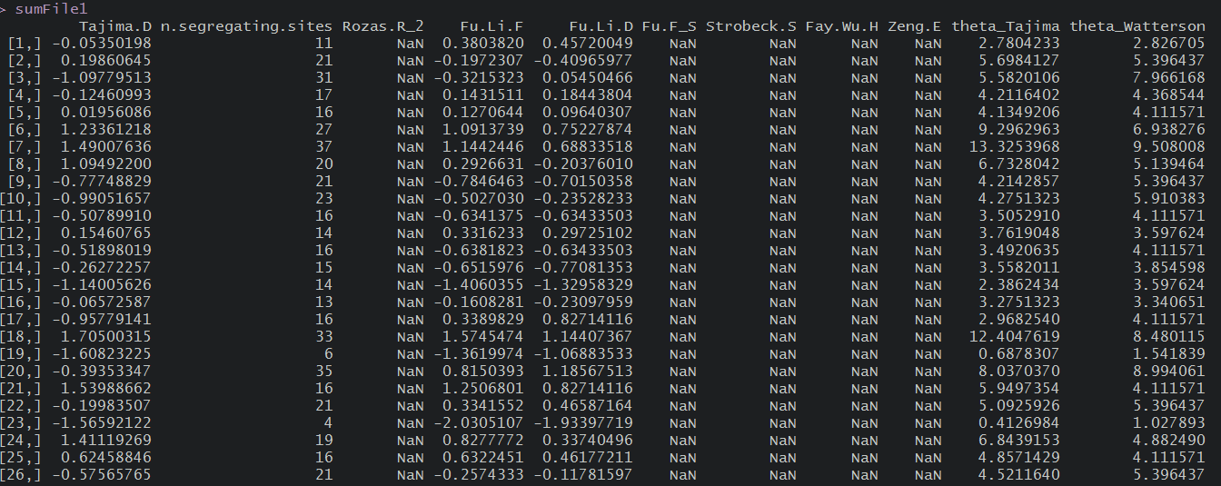
If we set theta=5, for niter=30, and NO GROWTH…the values of theta converge to 5, but the Tajima estimator variance is much bigger than Watterson index.
mean(sumFile1[,"theta_Tajima"]) [1] 5.168695 var(sumFile1[,"theta_Tajima"]) [1] 9.678569
mean(sumFile1[,"theta_Watterson"]) [1] 4.942451 var(sumFile1[,"theta_Watterson"]) [1] 4.416086

Slide 8
Caveats with PopGenome
I still don’t figure it out how to calculate the number of haplotypes for our simulated populations, and we are suppose to need that.
There is some funny with the Pi estimated using the F_ST.stats module versus diversity.stats module. Both say they are using Nei’s diversity, but they difer in 0.2 at least, I tried that with the Noto file. Weird.

Slide 9
Comparing Pi and H from 2 modules
File1<-readData(“FastaSeqsPau”,include.unknown=T)
file1<-F_ST.stats(file1)
file1@hap.diversity.within pop 1
pico5.fasta 0.8888889
pico10.fasta 0.9052632
pico20.fasta 0.9538462
pico40.fasta 0.9759494
pico80.fasta 0.9726415
pico100.fasta 0.9730653
PicoAligned.fasta 0.9744361
file1@Pi pop 1
pico5.fasta 5.511111
pico10.fasta 6.021053
pico20.fasta 5.769231
pico40.fasta 5.964557
pico80.fasta 4.905346
pico100.fasta 4.840201
PicoAligned.fasta 4.922853
file2<-readData("FastaSeqsPau",include.unknown=T)
> diversity.stats(file2,pi=TRUE)->file2 file2@hap.diversity.within pop 1
pico5.fasta 0.8888889
pico10.fasta 0.9052632
pico20.fasta 0.9538462
pico40.fasta 0.9759494
pico80.fasta 1.0789308
pico100.fasta 1.0578894
PicoAligned.fasta 1.0551834
file2@Pi #also says is Nei's pi pop 1
pico5.fasta 5.511111
pico10.fasta 6.021053
pico20.fasta 5.769231
pico40.fasta 5.964557
pico80.fasta 4.613522
pico100.fasta 4.642412
PicoAligned.fasta 4.763545
The differences between modules increases with sample size, with n of 5 or 10 the values are identical with the two modules

Slide 10
Reading MS data
readMS (popGenome) read.ms.output (gap)
Input, noto file (19 seq) with niter=10
List of 9
$ call : chr "ms.exe 38 10 -t 1.5190"
$ seed : num 21538
$ nsam : int 38
$ nreps : int 10
$ segsites : int [1:10]
$ gametes :List of 10

